Slide 1

BREAST CANCER PREDICTION
Machine Learning & Data Analysis
Final Project 2021/2022
Dataset: Breast Cancer Wisconsin (Diagnostic) Data Set
Software Tool: Google Colaboratory
Programming Language: Python
Patrone Paolo (S4643377) Raffo Matteo (S4620552)

Slide 2

Dataset Introduction
Attribute Information:
ID number
Diagnosis (M = malignant, B = benign)
Ten real-valued features are computed for each cell nucleus:
Radius (mean of distances from center to points on the perimeter)
Texture (standard deviation of gray-scale values)
Perimeter
Area
Smoothness (local variation in radius lengths)
Compactness
Concavity (severity of concave portions of the contour)
Concave points (number of concave portions of the contour)
Symmetry
Fractal dimension
We have chosen it because in the medical world prevention is never too much and through research it is possible to prevent and treat many diseases that could otherwise be fatal
We decided to use this dataset to predict whether a patient has benign or malignant breast cancer based on properties of the cancer
1

Slide 3

Algorithms
01
02
Decision Tree
Random Forest
Main purpose: To predict whether a person has benign cancer or malignant cancer we use and compare these 2 models / algorithms
2

Slide 4
Steps and goals
Dataset Reading and Correction
Observations
Data Preparation
Prediction without tuned parameters
Prediction with tuned parameters
Conclusions
3

Slide 5
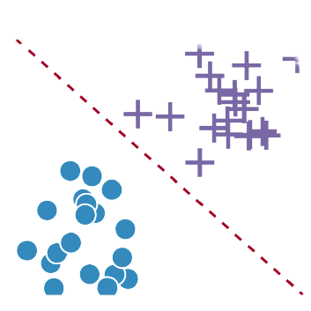
About Classification
The classification algorithm is a supervised learning technique that is used to identify the category of new observations based on the training data.
The goal of the classification algorithm is to identify the category of a given data set
There are two types of classifications:
Binary Classifier: If the classification problem has only two possible outcomes
Multiclass Classifier: If a classification problem has more than two results
In our project we have a binary classification, because we have 2 classes: Benign cancer and Malignant cancer
A classifier utilizes some training data to understand how given input variables relate to the class
4

Slide 6
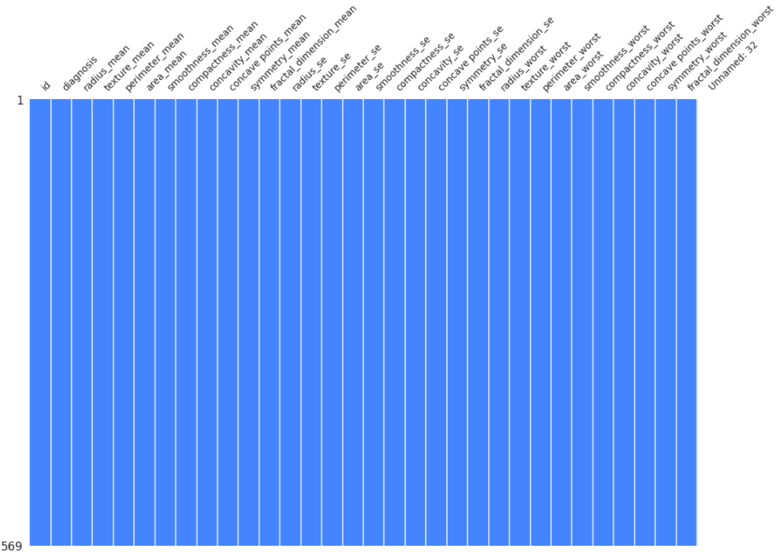
Dataset Reading and Correction
In this phase:
We acquire the dataset
We realize that all the values of the "Unnamed: 32" column are null
Since the entire column contains null values, we have decided to delete it from the dataset
Finally we check and see that there are no more null values
5

Slide 7
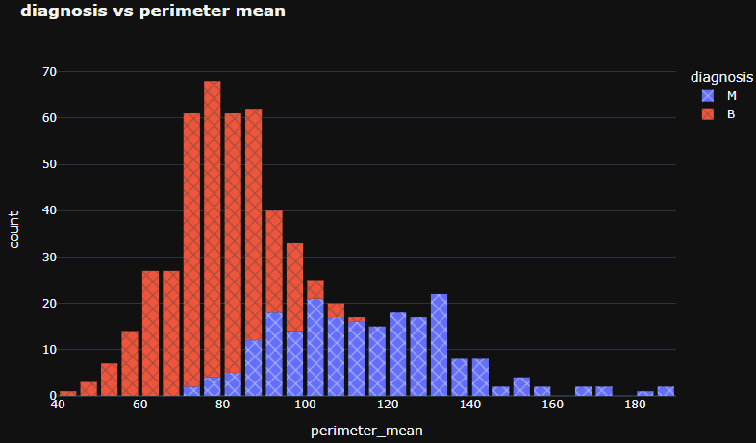
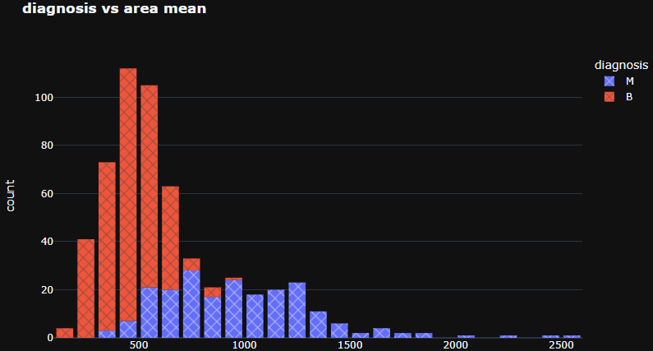
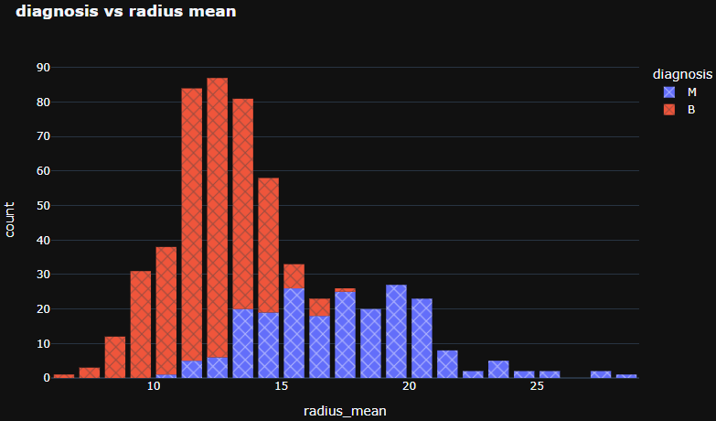
Observations
The higher the perimeter mean of the tumor, the more likely it is to be a malignant tumor
Up to 700 area mean value cancer tumors of type B are more, instead from 700 area mean value cancer tumors of type M are more
The higher the radius mean of the tumor, the more likely it is to be a malignant tumor
N.B.: For other observations using other graphs, look at the .ipynb file created with Google Colaboratory
6

Slide 8
Smote
Before moving on to creating the ML models we must first improve the dataset so that our models run at their best. We do this by converting all values ​​to numbers and applying the SMOTE algorithm
When use SMOTE?
Our dataset is slightly unbalanced, the number of elements with Diagnosis cancer at 1 has fewer elements than Diagnosis at 0 and this could affect accuracy to ours ML models
It is necessary to use it?
Since the random forest model is built on decision trees and decision trees are sensitive to class imbalance, it is essential to use a balanced dataset
7

Slide 9
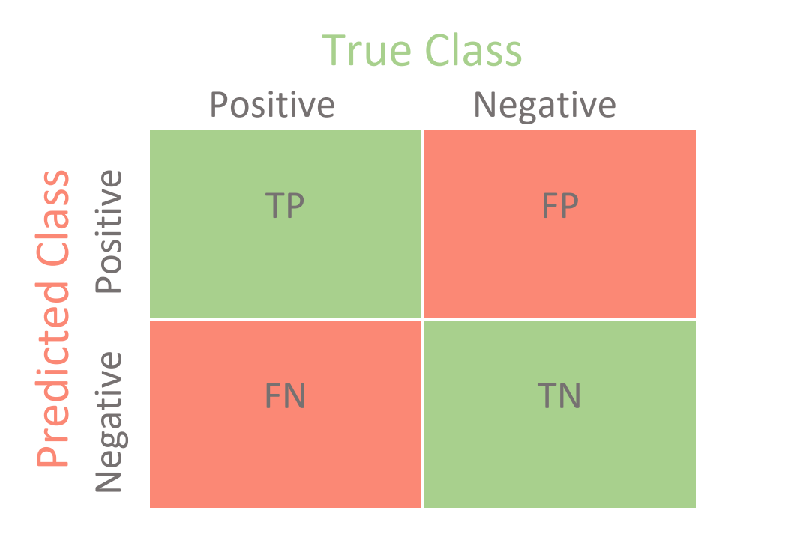
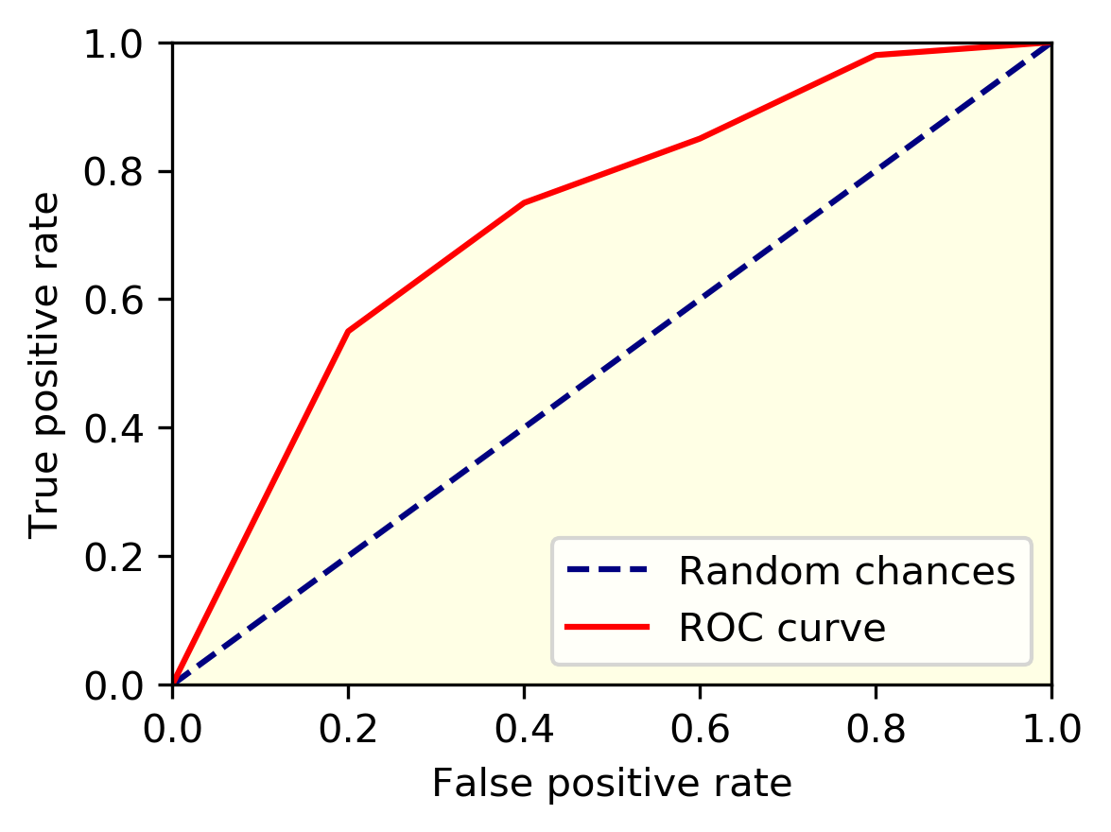
ROC and Confusion Matrix
First we will train the model on the train data and then we will run it on the test data
Precision: The ratio between correct elements and total elements will be expressed as a percentage, this will tell us the accuracy of the prediction
Confusion Matrix: This matrix is ​​composed of 2 rows and 2 columns and indicates the predicted values ​​corresponding to the real values. In this way we could evaluate both which targets were predicted correctly and which ones were wrong
ROC: This concept is plotted with the ROC curve (Receiver operating characteristic). True Positive Rate (TPR, fraction of true positives) on Y axes and False Positive Rate (FPR, fraction of false positives) on X axes. The yellow area is called AUC and tells us if we have many correct values over the wrong ones
8

Slide 10

Prediction without tuned parameters
In this phase:
We train our models on our dataset
We use confusion matrix to evaluate the accuracy of the classification to estimate the skill of machine learning models
Finally we are able to compare the models at the end of the training
9

Slide 11

Prediction with tuned parameters
In this phase:
With GridSearchCV(...) we find the best parameters and the best accuracy for each model
We use them to train and test all models
Also in this case to evaluate and estimate the skill of machine learning models we use metrics
Finally, thanks to these metrics, we are able to compare the models at the end of testing
10

Slide 12

Decision Tree Tuned Parameters
The parameter tuning needs in order to find the best parameters.
The parameters we are going to use are:
Max Depth: The max depth of the tree
Max_features: The number of features to consider when looking for the best split
Min_samples_leaf: The min number of samples required to be at a leaf node
Min_sample_split: The min number of samples required to split an internal node
11

Slide 13
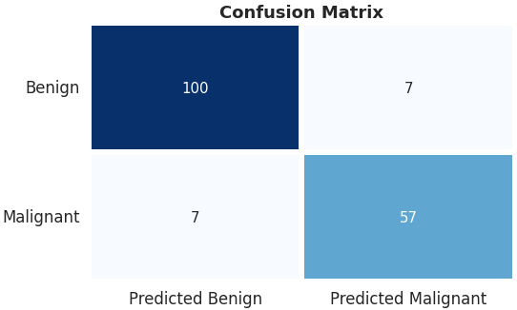
Decision Tree Tuned Parameters
12

Slide 14
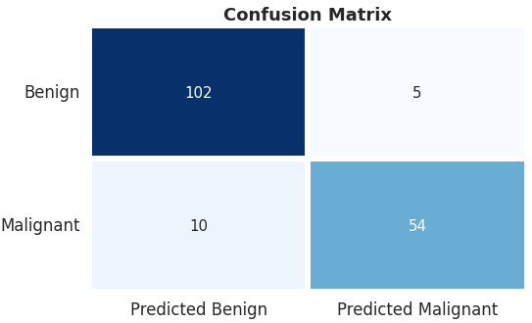
Decision Tree with vs without Tuning
Before tuning
After tuning
Accuracy :
~91%
~92%
13

Slide 15
Random Forest Tuned Parameters
The parameter tuning needs in order to find the best parameters.
Hyperparameters
Bootstrap values: Number of values extracted from the bootstrap → default: 2/3
Max features: The max number of features I look at each node → default: sqrt(n_features)
Max depth: depth of trees / number of leaves → default: None
Other important parameters
N_estimators: Number of trees → default: 100
Algorithm for voting → default: Majority Voting
Min sample leaf: The min number of samples required to be at a leaf node → default: 1
Min sample split: The min number of samples required to split an internal node → default: 2
14

Slide 16
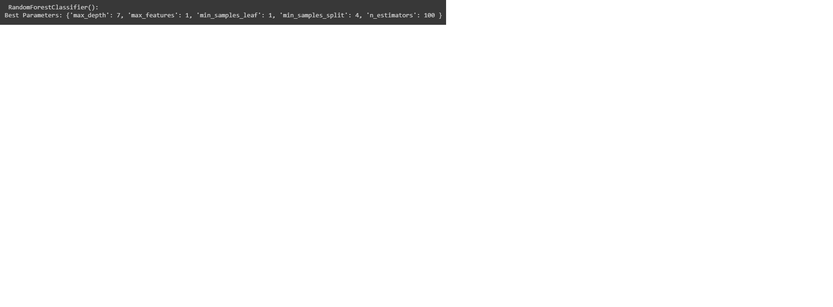
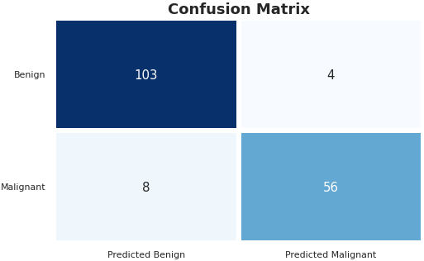
Random Forest Tuned Parameters
15

Slide 17
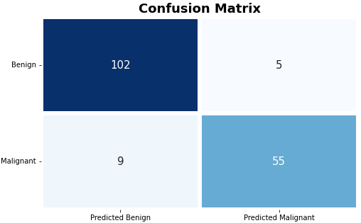
Random Forest with vs without Tuning
Before tuning
After tuning
Accuracy :
~92%
~93%
16

Slide 18

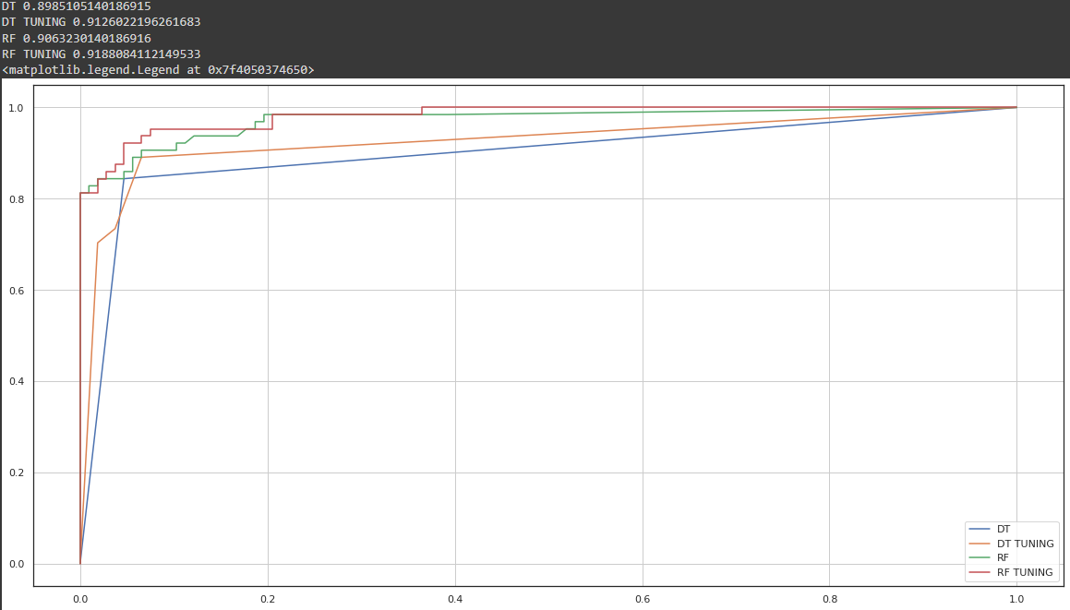
Conclusions
Accuracy
DT
~91%
DT Tuning
~92%
RF
~92%
RF Tuning
~93%
17

Slide 19
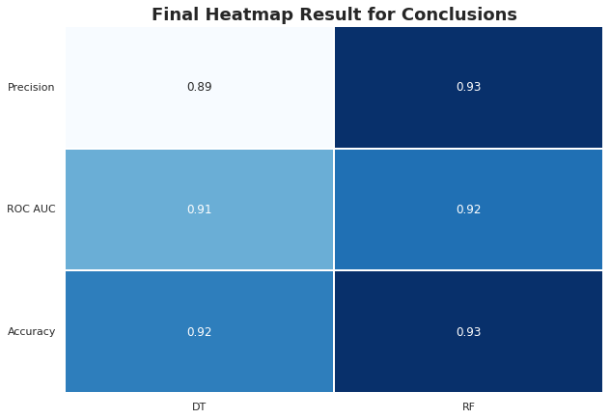
Conclusions
These two algorithms can predict who has had benign cancer or malignant cancer quite well
The best classifier for not labeling a benign sample that is not benign is Random Forest (highest accuracy)
The best classifier not to label as positive a sample that is negative (as we can see from the precision value) is Random Forest
18

Slide 20

THANKS FOR THE ATTENTION!
References:
Our .ipynb document created with Google Colaboratory
Machine Learning Classifiers - towardsdatascience.com
Introduction to Random Forest in Machine Learning - section.io
Decision Trees for Classification: A Machine Learning Algorithm - xoriant.com
SMOTE for Imbalanced Classification with Python
Patrone Paolo (S4643377) - Raffo Matteo (S4620552)

